Slide 1


http://pingo.edu.vn/khoa-hoc-php-can-ban/
PHP Basics – Database - MySQL
Web Applications in Hatch
Tuan Duong
http://pingo.edu.vn/tuan-duong/

Slide 2
Contents
Database Concept
File Processing System
Database Management System
MySQL Database

Slide 3
Database Concept
Database can be defined as a collection
of information organized in such a way that
it can be accessed easily.
Examples of database:
Telephone directory
Tracking customer orders
Maintain employees records

Slide 4
Database Terminologies
Data
- This is the fact, or about specific entity (person, place or thing)
Information
- Is the data that have been processed and is useful to the user
Field
- Is a single item of information or data in entity e.g. employee name
Record
- Is a group of fields about an entity, example Employee’s information

Slide 5
MANUAL FILE SYSTEM
USER
FILE KEEPER
FILE CABINET

Slide 6
FILE PROCESSING SYSTEM
Information stored as group of records in separate files
File systems consisted of a few data files and many application programs
Each file called a soft file
Flat file contained the processed information for one specific function
Use of programming languages to write applications

Slide 7
File processing systems structure
Customer file
Customer
Processing
Application
Customer file
User 1
Rental
Processing
Application
Rental file
Rental file
User 2

Slide 8
Limitation of File Processing system
Separate and isolated data
To make decision, user might need data from more
than one file
Data redundancy
often the same information was stored in more than one file, in addition to taking up more space in the system, this cause loss of data integrity
Program
data independence for file formats and access techniques

Slide 9
Limitation of File Processing system
Difficult in representing data from user’s view
To create useful application for user, often data from various files must be combined. In file processing system, it was difficult to determine the relationship between isolated data in order to meet user requirement.
Data inflexibility
Program-data independency and data isolation limited the flexibility of the file processing system in providing user requirement
Due to this limitations, the concept of
Data base management system (DBMS) was born

Slide 10
DATA BASE MANAGEMENT SYSTEM (DBMS)
Is a program that allows users to define, create, manipulate, store, maintain retrieve and process the data in the data base in order to produce meaningful information.
Focus on information presentation
Data stored as a records in various database files that can be combined to produce meaningful information for users
It controls all functions of capturing, processing, storing, retrieving data and generates various forms of data output
Manage access by multiple users and multiple programs to common stored data.
And hence it overcomes all limitations of FPS

Slide 11
DBMS STRUCTURE
USER 1
DBMS
DATABASE
USER 2
USER 3

Slide 12
CHARACTERISTICS OF DBMS
Computerized record keeping system
Contain facilities that allow user to:
a. Add, and delete files
b. Insert, retrieve, update, delete data
Collection of databases; each can be used for separate purposes or combined

Slide 13
EXAMPLES OF DBMS
Ms ACCESS
SQL SERVER
ORACLE
MY SQL

Slide 14
FUNCTIONS OF DBMS
To store data
To organize data
To control access to data
To protect data

Slide 15
ADVANTAGES OF DBMS
Centralized data reduce management problems
Data redundancy and consistency are controllable
Program-data interdependence is diminished
Flexibility of data is increased

Slide 16
DISADVANTAGES OF DBMS
Reduction in speed of data access time
Require special knowledge
Possible dependency of application programs to specific DBMS versions

Slide 17
FLAT DATABASE MODEL
The earliest and simplest database model
Is a way of organizing information in a single table
Is good only for simple database
Possible redundancy of data

Slide 18
HIERARCHICAL DATABASE MODEL
As its name implies, the hierarchical database model defines hierarchically arrangement of data
Is like upside down tree
A single table acts as a root of the database from which the other table branches out
Relationship in such system are thought of in terms of children an parents, such as a children may have only one parent but a parent can have multiple children

Slide 19
HIERARCHICAL DATABASE MODEL
Parents and children are tied together by links called “pointers”
More efficient than Flat database
Has some serious problems, that you can not add a record to a child table until it has already been incorporated with the parent
Redundancy of data may occur because it does not handle many to many relationship

Slide 20
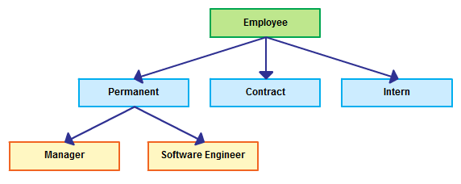
HIERARCHICAL DATABASE MODEL

Slide 21
NETWORK DATABASE MODEL
It was designed to solve problems of hierarchical data base model
It solves the problem of data redundancy by representing relationship in terms of sets rather than hierarchy
It is similar to the hierarchical model, in fact the hierarchy model is a subset of network model
But this model was difficult to implement, so another simple model was developed, which is RELATIONAL DATABASE MODEL

Slide 22
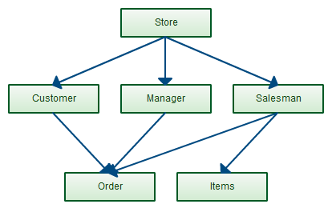
NETWORK DATABASE MODEL

Slide 23
RELATIONAL DATABASE MODEL
Is a collection of data items organized as a set of formally-describes tables from which data can be accessed or reassembled in many different ways without having to reorganize the data base tables
A collection of data organized in two-dimensional tables consisting of named columns and rows
It is easy to create
It is easy to extend, after original database creation.
The core of Relational data base model is the concept of table, which is also called relation in which all data is stored

Slide 24
RELATIONAL DATABASE MODEL
Each table is made up of records (horizontal rows also known as tuples) and fields (vertical column also known as attributes)
Table-is a two dimensional representation of data consisting of column and zero or more rows*
The table name must be unique
The table name must be descriptive
Column name must be unique within the table, however those columns in different tables my share the same name
Rows must be unique

Slide 25
RELATIONAL DATABASE MODEL
Null values-is a missing or unknown value in a column of a table, null are not the same as zeros
Primary key (PK)-is the column or group of columns whose values uniquely identify each row of a table
Every table must have only one PK
PK must always have a value
PK must be unique
Foreign key is a column or group of columns that is a primary key in another table, it relates the rows of the table to other rows that appear elsewhere in another table

Slide 26
RELATIONAL DATABASE MODEL
Entities: This defines a thing that exist and is distinguishable from which data will be collected, e.g person, place or object.
Relationship: A relationship is a connection between entity classes.
- Example, relationship between PERSONS and AUTOMOBILES could be an “OWNS”
That is to say , people own automobile
Types of relationship: We have three types of relationship
1.one-to-one
2. One-to-many
3.Many-to-many

Slide 27
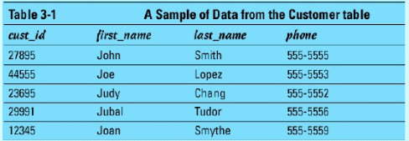
RELATIONAL DATABASE MODEL
Example: Table Customer

Slide 28
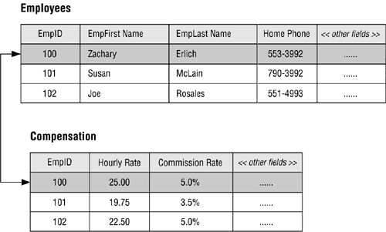
RELATIONAL DATABASE MODEL
Example: One-to-One Relationship

Slide 29
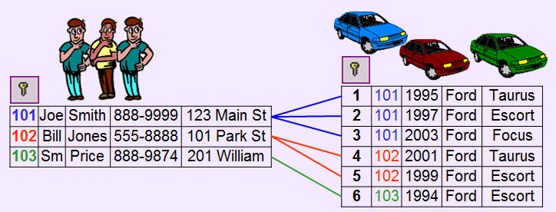
RELATIONAL DATABASE MODEL
Example: One-to-Many Relationship

Slide 30
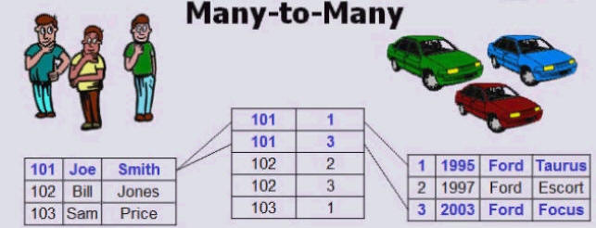
RELATIONAL DATABASE MODEL
Example: Many-to-Many Relationship

Slide 31
MySQL
A MySQL database is nothing in itself. Rather a MySQL database is a way of organizing a group of tables. If you were going to create a bunch of different tables that shared a common theme, you would group them into one database to make the management process easier.

Slide 32
MySQL Syntax
There are many keywords in MySQL, and a good programming habit when using ANY of these words is to capitalize them. This helps draw them out from the rest of the code and makes them much easier to read. Below is an example of a MySQL query written in PHP that retrieves all the data from a MySQL table named 'example'.
$result = mysql_query('SELECT * FROM example')
That line of code is valid PHP, but it also contains valid MySQL. The text that appears between the quotations 'SELECT * FROM example', is the MySQL code.
As you probably can tell 'SELECT' and 'FROM' are the MySQL keywords used in this query. Capitalizing them allows you to tell from a quick glance that this query selects data from a table.

Slide 33
Creating your first database
Server - localhost Database - test Table - example Username - root Password -

Slide 34
MySQL localhost
If you've been around the internet a while, you'll know that IP addresses are used as identifiers for computers and web servers. In this example of a connection script, we assume that the MySQL service is running on the same machine as the script.
When the PHP script and MySQL are on the same machine, you can use localhost as the address you wish to connect to localhost is a shortcut to just have the machine connect to itself. If your MySQL service is running at a separate location you will need to insert the IP address or URL in place of localhost.

Slide 35
MySQL connect
Before you can do anything with MySQL in PHP you must first establish a connection to your web host's MySQL database. This is done with the MySQL connect function.

Slide 36
MySQL connect
Before you can do anything with MySQL in PHP you must first establish a connection to your web host's MySQL database. This is done with the MySQL connect function.

Slide 37
Example
<?php
mysql_connect(“server', “database', “password') or die(mysql_error());
echo 'Connected to MySQL&lt;br/&gt;';
mysql_select_db('test') or die(mysql_error());
echo 'Connected to Database';
?>
//Connected to MySQL
// Connected to Database

Slide 38
MySQL Tables
A MySQL table is completely different than the normal table that you eat dinner on. In MySQL and other database systems, the goal is to store information in an orderly fashion. The table gets this done by making the table up of columns and rows.

Slide 39
Creating Table
Before you can enter data (rows) into a table, you must first define what kinds of data will be stored (columns). We are now going to design a MySQL query to summon our table from database land.

Slide 40
Example
<?php
// Make a MySQL Connection
mysql_connect('server', 'database', 'password') or die(mysql_error());
mysql_select_db('test') or die(mysql_error());
// Create a MySQL table in the selected database
mysql_query('CREATE TABLE example(
id INT NOT NULL AUTO_INCREMENT,
PRIMARY KEY(id),
name VARCHAR(30),
age INT)'
) or die(mysql_error());
echo 'Table Created!';
?>

Slide 41
Creating Table
mysql_query (’CREATE TABLE example'
The first part of the mysql_query told MySQL that we wanted to create a new table. The two capitalized words are reserved MySQL keywords.
The word 'example' is the name of our table, as it came directly after 'CREATE TABLE'. It is a good idea to use descriptive names when creating a table, such as: employee_information, contacts, or customer_orders. Clear names will ensure that you will know what the table is about when revisiting it a year after you make it.

Slide 42
Creating Table
'id int not null auto_increment'
Here we create a column 'id' that will automatically increment each time a new entry is added to the table. This will result in the first row in the table having an id = 1, the second row id = 2, the third row id = 3, and so on.
The column 'id' is not something that we need to worry about after we create this table, as it is all automatically calculated within MySQL.
Reserved MySQL Keywords:
Here are a few quick definitions of the reserved words used in this line of code:
INT - This stands for integer or whole number. 'id' has been defined to be an integer.
NOT NULL - These are actually two keywords, but they combine together to say that this column cannot be null. An entry is NOT NULL only if it has some value, while something with no value is NULL.
AUTO_INCREMENT - Each time a new entry is added the value will be incremented by 1.

Slide 43
Creating Table
primary key (id)'
PRIMARY KEY is used as a unique identifier for the rows. Here we have made 'id' the PRIMARY KEY for this table. This means that no two ids can be the same, or else we will run into trouble. This is why we made 'id' an auto-incrementing counter in the previous line of code.

Slide 44
Creating Table
primary key (id)'
PRIMARY KEY is used as a unique identifier for the rows. Here we have made 'id' the PRIMARY KEY for this table. This means that no two ids can be the same, or else we will run into trouble. This is why we made 'id' an auto-incrementing counter in the previous line of code.

Slide 45
Creating Table
'name varchar(30),'
Here we make a new column with the name 'name'! VARCHAR stands for 'variable character'. 'Character' means that you can put in any kind of typed information in this column (letters, numbers, symbols, etc). It's 'variable' because it can adjust its size to store as little as 0 characters and up to a specified maximum number of characters.
We will most likely only be using this name column to store characters (A-Z, a-z). The number inside the parentheses sets the maximum number of characters. In this case, the max is 30.

Slide 46
Creating Table
'name varchar(30),'
Here we make a new column with the name 'name'! VARCHAR stands for 'variable character'. 'Character' means that you can put in any kind of typed information in this column (letters, numbers, symbols, etc). It's 'variable' because it can adjust its size to store as little as 0 characters and up to a specified maximum number of characters.
We will most likely only be using this name column to store characters (A-Z, a-z). The number inside the parentheses sets the maximum number of characters. In this case, the max is 30.

Slide 47
Creating Table
'age int,'
Our third and final column is age, which stores an integer. Notice that there are no parentheses following 'INT'. MySQL already knows what to do with an integer. The possible integer values that can be stored in an 'INT' are -2,147,483,648 to 2,147,483,647, which is more than enough to store someone's age!
'or die(mysql_error());'
This will print out an error if there is a problem in the table creation process.

Slide 48
MySQL insert
When data is put into a MySQL table it is referred to as inserting data. When inserting data it is important to remember the exact names and types of the table's columns. If you try to place a 500 word essay into a column that only accepts integers of size three, you will end up with a nasty error!

Slide 49
MySQL insert
<?php
// Make a MySQL Connection
mysql_connect('localhost', 'admin', '1admin') or die(mysql_error());
mysql_select_db('test') or die(mysql_error());
// Insert a row of information into the table 'example'
mysql_query('INSERT INTO example (name, age) VALUES('Timmy Mellowman', '23' ) ') or die(mysql_error());
mysql_query('INSERT INTO example (name, age) VALUES('Sandy Smith', '21' ) ') or die(mysql_error());
mysql_query('INSERT INTO example (name, age) VALUES('Bobby Wallace', '15' ) ') or die(mysql_error());
echo 'Data Inserted!';
?>

Slide 50
MySQL query
<?php
// Make a MySQL Connection
mysql_connect('localhost', 'admin', '1admin') or die(mysql_error());
mysql_select_db('test') or die(mysql_error());
// Insert a row of information into the table 'example'
mysql_query('INSERT INTO example (name, age) VALUES('Timmy Mellowman', '23' ) ') or die(mysql_error());
mysql_query('INSERT INTO example (name, age) VALUES('Sandy Smith', '21' ) ') or die(mysql_error());
mysql_query('INSERT INTO example (name, age) VALUES('Bobby Wallace', '15' ) ') or die(mysql_error());
echo 'Data Inserted!';
?>

Slide 51
MySQL insert
So far we have seen a couple different uses of PHP's mysql_query function and we'll be seeing more of it as nearly all MySQL in PHP is done through the MySQL Query function. We have already created a new table and inserted data into that table. In this lesson we will cover the most common MySQL Query that is used to retrieve information from a database.

Slide 52
Retrieving data with PHP & MySQL
<?php
// Make a MySQL Connection
mysql_connect('server', 'user', 'password') or die(mysql_error());
mysql_select_db('test') or die(mysql_error());
// Retrieve all the data from the 'example' table
$result = mysql_query('SELECT * FROM example') or die(mysql_error());
// store the record of the 'example' table into $row
$row = mysql_fetch_array( $result );
// Print out the contents of the entry
echo 'Name: '.$row['name'];
echo ' Age: '.$row['age'];
?>

Slide 53
Retrieving data with PHP & MySQL
Usually most of the work done with MySQL involves pulling down data from a MySQL database. In MySQL, data is retrieved with the 'SELECT' keyword. Think of SELECT as working the same way as it does on your computer. If you wanted to copy some information in a document, you would first select the desired information, then copy and paste.

Slide 54
QUESTIONS

